Slide 1

E-commerce Records Analysis Report
Helena Li, Data Analyst
JR Academy

Slide 2
Report Content
business Purpose
Sales Data Exploration
Data Clustering
Recommendation

Slide 3
Business Purpose
Explore customer’ past behaviour and predict customer behaviour in the next sales period
Discover customer’ preferences in department, aisle, and product.
Discover the peak order time
Explore the pattern hidden in the data

Slide 4
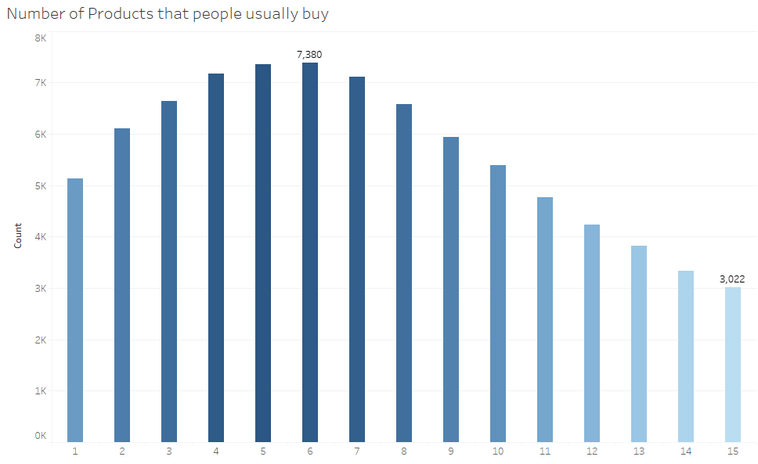
Data Exploration -Number of products that people usually buy

Slide 5
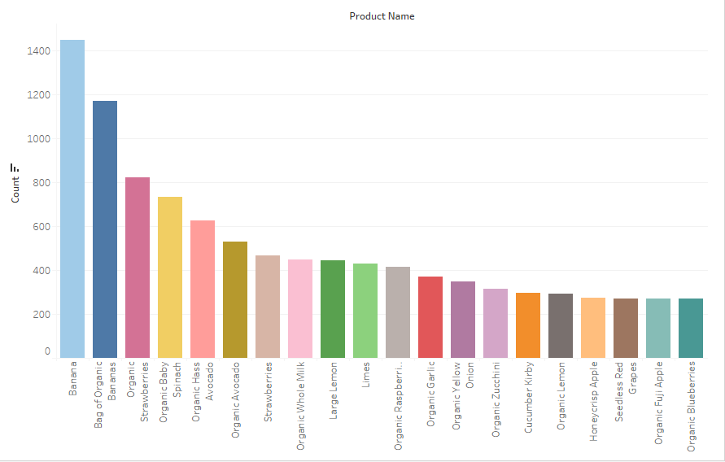
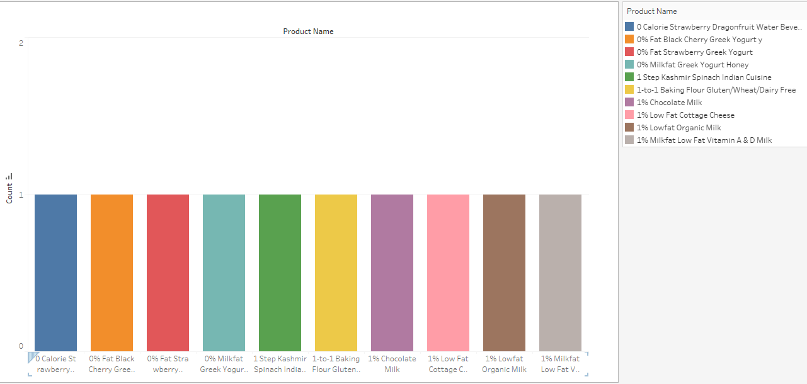
-Popular Product
-Unpopular Product

Slide 6
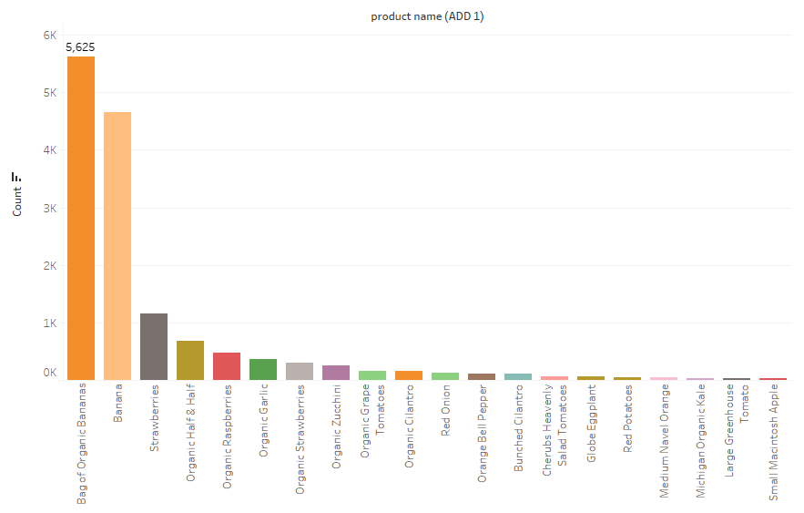
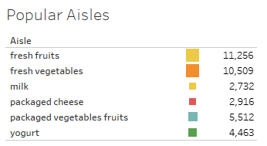
-Popular Product when add to cart is 1
-Popular Aisles

Slide 7
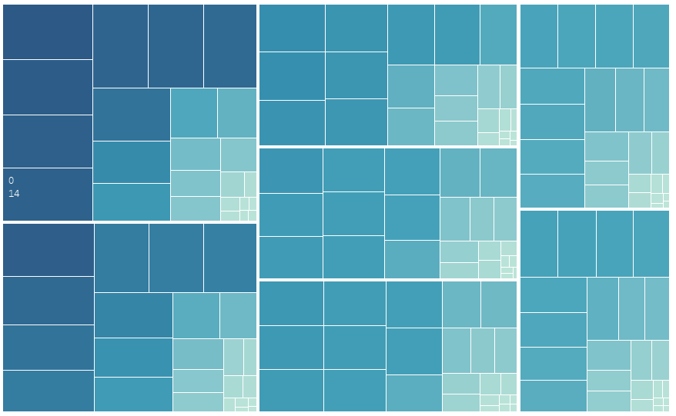
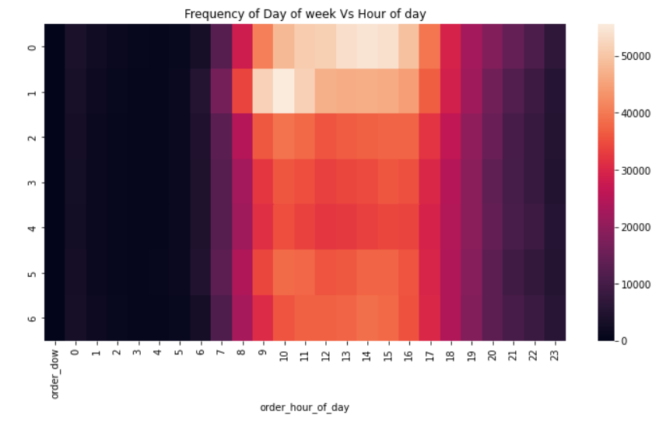
-Heatmap for order day of week and hour of time
Order day of week: 0 represents Sunday
Order hour of time: 14 represents 14 o’clock

Slide 8
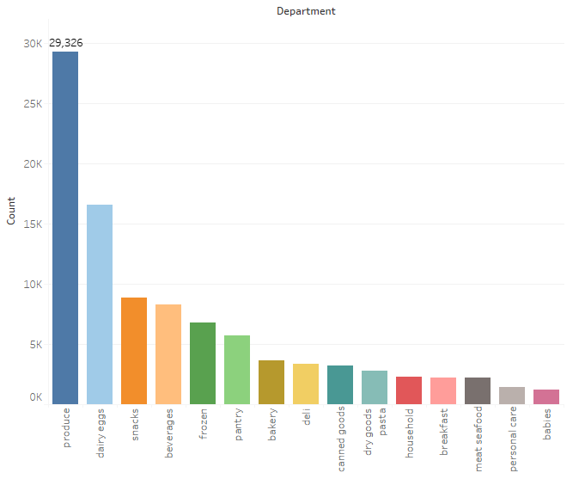
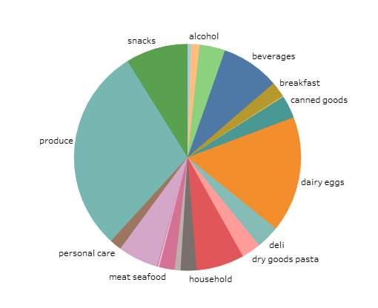
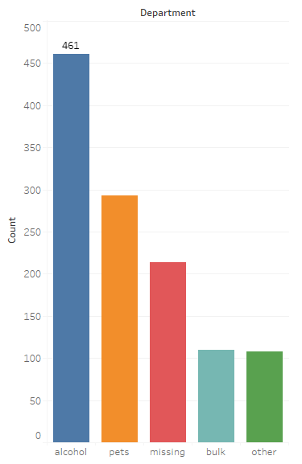
-Popular Department
-Department Distribution
Bottom 5 Departments
Produce: Agricultural products collectively, especially vegetables and fruits.

Slide 9
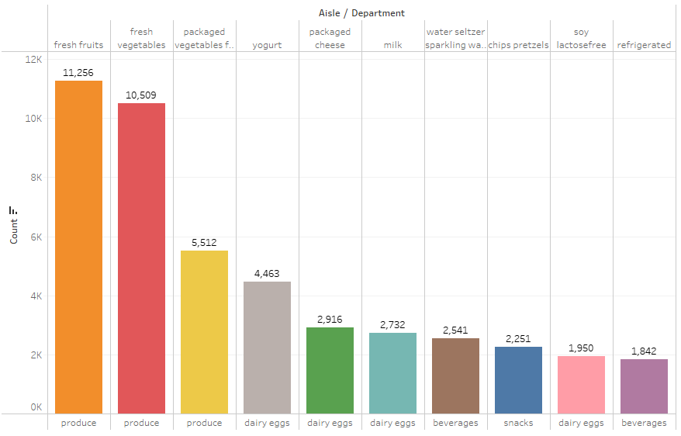
-Best Selling Aisles over All Departments

Slide 10
Data Clustering
Segregate groups with similar traits and assign them into clusters
Understand our customer better so that we can market our products better

Slide 11
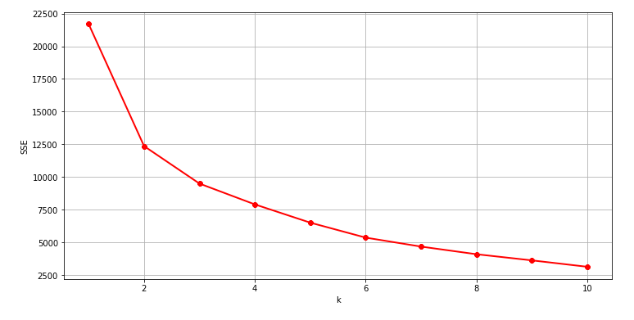
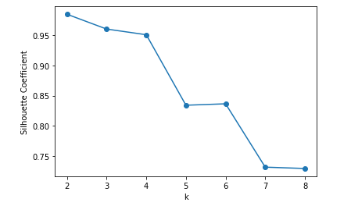
Data Clustering -Elbow Method
- Silhouette Coefficient Analysis

Slide 12
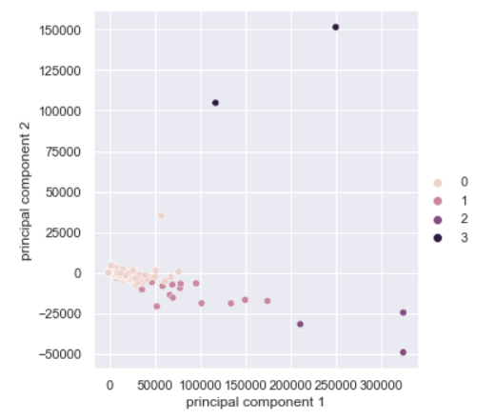
Data Clustering - Principal component analysis (PCA)
Reduce the dimensionality of a multivariate data to two or three principal components
Visualize data with minimal loss of information
Divide the customers into four categories

Slide 13
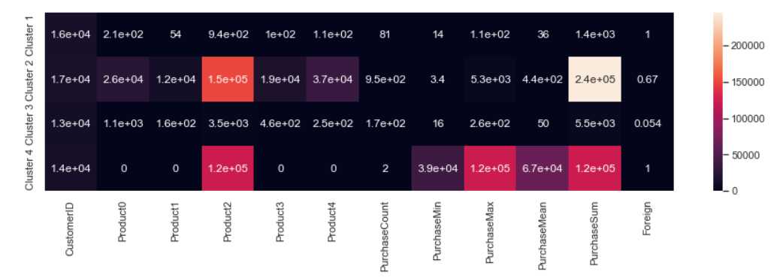
Data Clustering
Heatmap showing different features in each categories
Cluster 1 and 4 are purely composed of UK customers.
Cluster 2 has the largest purchase value sum and buys over all 5 products.
Cluster 4 only bought product 2 with only purchase twice while has a high purchase value sum. It means cluster 4 has bought expensive products.

Slide 14
Business Recommendation
Increase inventory and price of popular products like banana, bag of organic banana
Increase product categories, aisles in produce and dairy eggs departments
Avoid insufficient inventory issue in popular products in peak order time e.g. by increasing company’s order channels, order in different time
Reduce the price and inventory of unpopular products, and change manufacturer e.g. sales promotion
Remove unpopular products in unpopular departments, replace with similar product types in popular products and popular aisles
Comprehensive product marketing to customers in cluster 1, 2, 3
Limit product marketing to cluster 4 in specific products and aisles
Provide priority service to customer cluster 2 and 4 which take large percentage in sales

Slide 15
Thank You!

